Slide 1

Media Center Extender Technology Overview
Todd Bowra
Lead Program Manager
Microsoft Corporation

Slide 2
Session Goals
Understand what Media Center Extender is
Understand how Extender works
Learn how to enable Extender technology on your consumer electronics device or device platform

Slide 3
Agenda
The PC and the digital home
Introduction to Media Center Extender
Demonstration
Extender device program
Program components
Adaptation kit approach
How to get involved in the device program

Slide 4
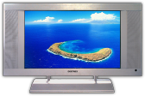
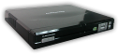
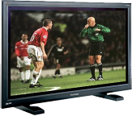
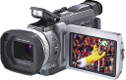


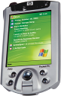

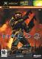
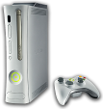
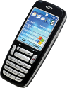


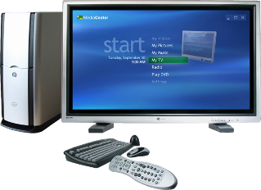


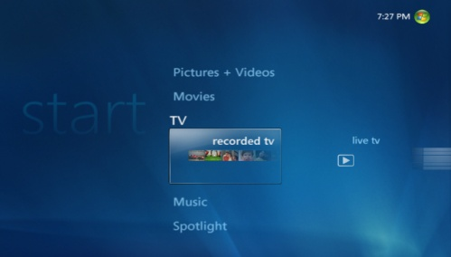

PC Uniquely Suited To Distribute Content Around The Home
content
devices
Photos
Videos
TV
Music
PlaysForSure devices
Smartphones
Portable Media Players
Media Center Extenders
Xbox 360

Slide 5
Media Sharing On Windows Guiding principles
“It just works”
Simple, intuitive and easy to use
Seamless Content Flow
Platform for media devices
Quality
Consumer Electronics-grade multimedia experiences
Device Reach
Extend content throughout the home media ecosystem

Slide 6
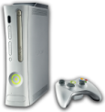

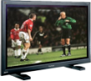

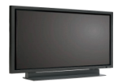
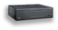
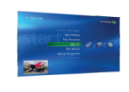

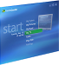
Media Sharing On Windows Two technology options available
PlaysForSure Network Devices
CON-T418: PlaysForSure Network Devices and Windows Vista
Media Center Extenders
CON-T411: Media Center Extender Technology: Overview
CON-T412: Media Center Extender Device Design

Slide 7
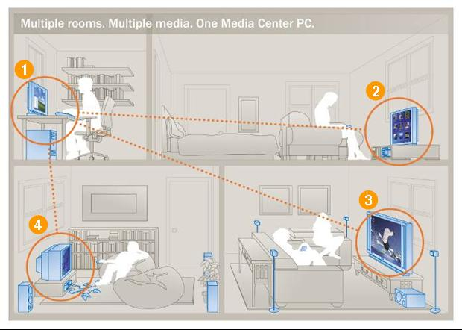
Media Center Extender Technology Whole home, high-definition entertainment
Windows Vista PC with Media Center
DVD player with built-in MCX streams online music and movies
Digital TV with built-in MCX streams photos and home videos
Xbox 360 with MCX streams music and live and recorded TV

Slide 8
MCX Technology Evolution
 | Windows XP |  | Windows Vista
 | MCX v1 | Xbox 360
Live/recorded TV (standard definition) | ☑ | ☑ | ☑
Music/videos/photos | ☑ | ☑ | ☑
Streaming over wireless home networks | ☑ | ☑ | ☑
Live/recorded TV (high definition) |  | ☑ | ☑
MCX host components included with Windows |  |  | ☑
OS- and platform-independent porting kit |  |  | ☑

Slide 9





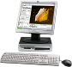

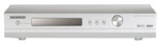

Media Center Extender Complete network entertainment
Full Media Center experience: TV/PVR, 3rd party applications
Windows Vista Home Premium or Ultimate PC
Premium content via Windows Media DRM (WMDRM-ND)
Better experience
PlaysForSure Networked Device
Any Windows XP or Windows Vista PC
Personal content: Photos, music, video
DLNA compliant Network CE device (e.g., PVR)

Slide 10

What Is DLNA?
Establishes baseline protocols to enable device interoperability
CE to CE
PC to CE
Provides basic consumer scenarios
Digital Media Player (DMP)
Digital Media Server (DMS)
Device provides user interface
JPEG, LPCM, MPEG2
UPnP AV 1.0
UPnP Device
Architecture 1.0
HTTP 1.0/1.1
IPv4 Protocol Suite
Wired: 802.3i, 802.3u
Wireless: 802.11a/b/g

Slide 11



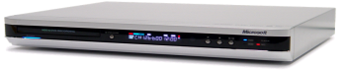
What Is PlaysForSure?
Internet
Media Services
Acquire
Stream
Enables content flow from Windows to consumer electronics devices
Download content to PC, then stream to TV
Protected content is downloaded and stored on the PC
Content is streamed from PC to device via protected link
Technology on the device
Builds on DLNA: Home Networked Device Interoperability Guidelines v1.0
Media formats: WMA, WMV, VC-1
WMDRM for Network Devices
UPnP-AV client
OEM User Interface

Slide 12

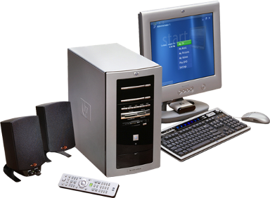
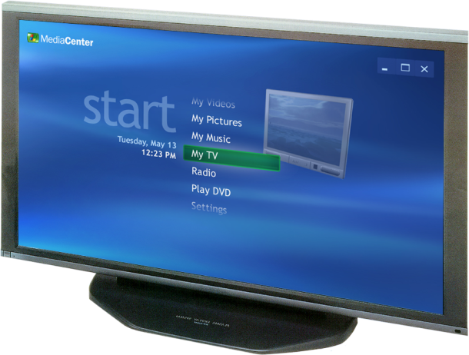
Software Stack For MCX
Online Media Applications
OEM Local UI
Key
Program Guide and Live/Rec TV
Remote UI
MCX
UI and content
Security/Trust
Media Center UI
WMDRM-ND
PFS
MPEG2
WMV
DLNA
Music, Photos, Videos
HTTP
RTP
UPnP AV
UPnP
IP/WiFi

Slide 13


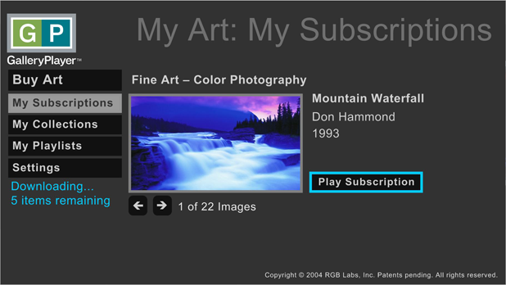

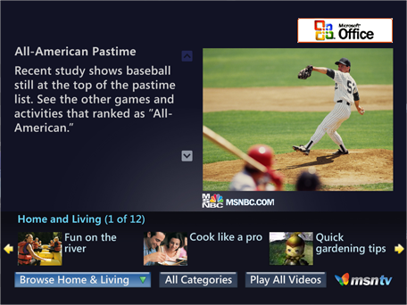

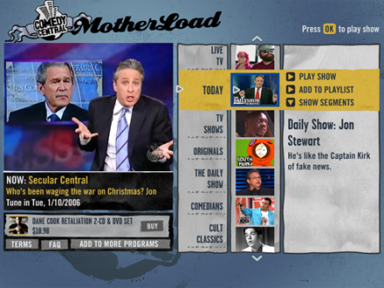
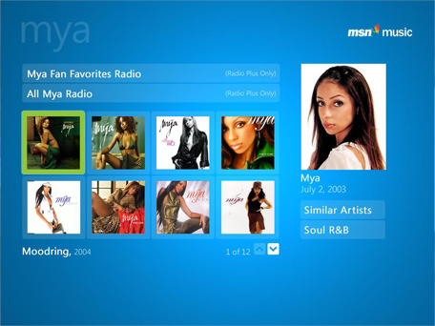


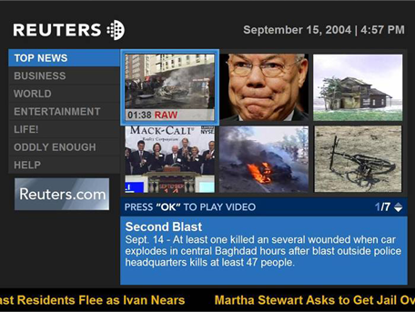
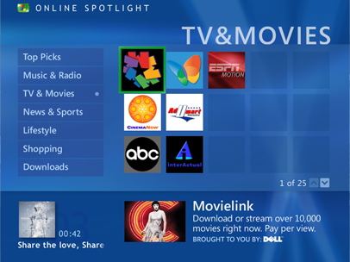
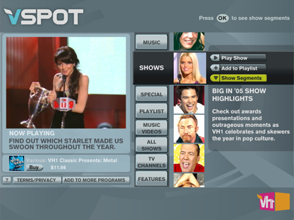
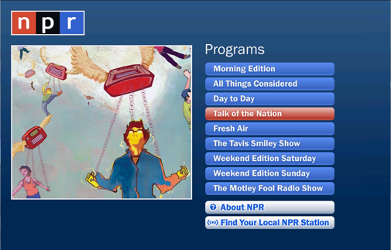
Application Remoting
Third-party applications hosted in Media Center

Slide 14
Feature Comparison
 | DLNA | PlaysForSure | MCX
Streaming over wireless home networks | ☑ | ☑ | ☑
Personal content sharing | ☑ | ☑ | ☑
Commercial content sharing |  | ☑ | ☑
Live TV streaming |  |  | ☑
High fidelity user interface remoting |  |  | ☑
Media Center user interface |  |  | ☑
Third-party application remoting |  |  | ☑

Slide 15
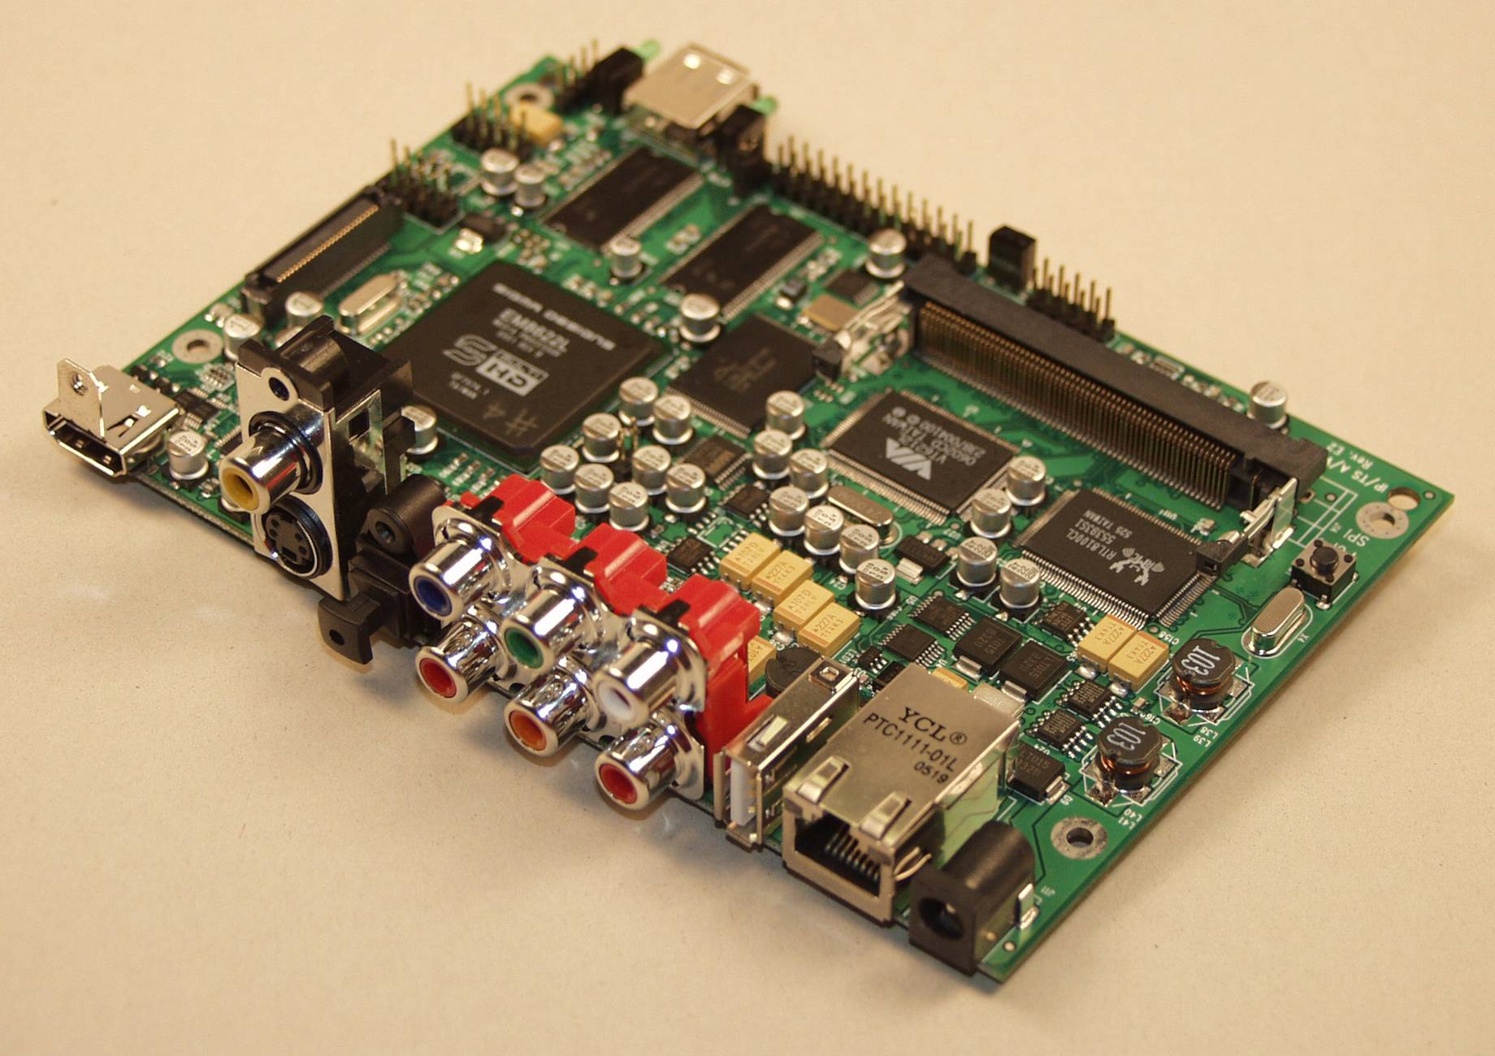

Pika 8622L Reference Board

Slide 16

Media Center Extender On Sigma Designs Pika 8622L Reference Board
demo
Todd Bowra
Lead Program Manager
Media Center Devices

Slide 17
Media Center Extender Device Program

Slide 18
MCX Device Program Vision
Keep costs negligible
Low resource requirements
Minimal license fee
Builds upon existing device investments
Not tied to specific hardware platform or Operating System (OS)
Enable device differentiation
MCX ‘feature’ can be added to a variety of devices
Functional extensions (e.g., additional media formats)
Consumers gain the complete range of media experiences powered by Windows

Slide 19
MCX Device Program Components
“KickStart” program
Platform requirements and UX guidelines
Developer’s Guide and Platform SDK documentation
Available to qualified companies under NDA
MCX Platform Adaptation Kit (MCX-PAK)
Collection of platform independent source code, documents, and unit tests
Supplies device technologies for MCX
Includes DLNA stack for use in MCX scenarios

Slide 20

MCX Architecture Overview
OEM Shell
PDK API
MCX
Components
(Included in
MCX-PAK)
OEM Provided Code
Platform dependent code
Provides OEM’s local experience
Starts MCX Experience
Microsoft Provided Code (MCX-PAK)
Platform independent code
Written entirely using PAL API
Provides MCX Experience
PAL API
Platform
Abstraction
Layer (PAL)
Platform Provided / OEM Modified Code
OEM’s implementation of PAL API
Sample implementation may be
provided by silicon provider
Embedded OS, Drivers, Hardware Libraries

Slide 21
MCX Architecture Overview
MCX Adaptation Kit (MCX-PAK)
Platform Independent Components
Application Programming
Interfaces
Supporting Materials
OEM Shell
PDK API
MCX
Components
(Included in
MCX-PAK)
Required
Components
Platform Development Kit (PDK) API
Unit Tests & Documentation
Optional
Components
PAL
API
Certification Tests
PAL API
Platform
Abstraction Layer (PAL)
MCX Platform Support Package (PSP)
Platform Dependent Implementation
Platform Development Environment
Embedded OS, Drivers, Hardware Libraries
Platform Abstraction Layer
Drivers & Libraries
Platform Build Base
Supporting Materials
Toolchain

Slide 22

MCX-PAK Contents
Required
Components
Provided as non-modifiable source code
Allows for easy cross-compile to a variety of target platforms
Platform Independent Components (PICs)
Optional
Components
Source code can be used as-is or replaced with alternate implementation
Implementations are recommended and tested, so carefully consider any replacements
Platform Development Kit API
Interface between OEM Application and MCX functionality
Handles notification to OEM Shell for local UI coordination
Application Programming Interfaces
Platform Abstraction Layer API
Interface between platform independent components and hardware and OS functions
Abstracts specifics of OEM hardware
Unit Tests and Documentation
Exercise individual PAL modules and PAK subsets for testing purposes
Collection of development guides and API documentation
Supporting Materials
Certification Tests
Test harness and scenario-based test cases
Includes sample media for AV test cases

Slide 23
MCX Platform Support Package (PSP)
Platform Abstraction Layer
Implementation of PAL API specific to a hardware and OS runtime combination
Customized for each target device
Platform Dependent Implementation
Platform Build Base
Build environment details for a specific platform
Defines platform data types, compiler directives, and makefiles
Drivers & Libraries
Runtime interface for accessing specialized hardware
Hardware drivers for interface with operating system
Platform Development Environment
Toolchain
Cross-compiler
Embedded runtime kernel
Supporting Materials
Developer documentation
Certificate compilation utilities
Image creation tools, debug tools, etc

Slide 24
MCX-PAK Detailed architecture
OEM Shell
Module type
OEM
MCX Client
Session
Manager
Platform
Independent
Component
LLTD
Client
NPT
Sink
WMDRM-ND
Receiver
RTSP/RTP
Client
XSP
Client
MSTA
Service
MSRX
Service
PAL
Platform Abstraction Layer (PAL) APIs
Optional
Module
Graphics
AV Render
Sockets
Input
Executive
Security
UPnP
TLS
Graphics
AV
Render
Sockets
Input
Executive
Security
Windows Media
Connectivity Stack
PAK
Embedded OS, Drivers, Hardware Libraries

Slide 25
Platform Independent Components
MCX Client
Session
Manager
LLTD
Client
NPT
Sink
WMDRM-ND
Receiver
RTSP/RTP
Client
XSP
Client
MSTA
Service
MSRX
Service
Platform Abstraction Layer (PAL) APIs
Graphics
AV Render
Sockets
Input
Executive
Security
UPnP
TLS
Platform Independent Component | Definition | Function
LLTD Client (with QoS Extensions) | Link Layer Topology Discovery | Enables Windows Vista to reflect device location on the Network Map Provides real-time bandwidth monitoring
NPT Sink | Network Performance Tuner | Enables network throughput testing and diagnostics
WMDRM-ND Receiver | Windows Media DRM for Network Devices | Link for streaming of premium AV content Includes: discovery, proximity detection, authorization, key exchange, and content decryption
RTSP Client | Real Time Streaming Protocol | Streams audio and video over the network using RTP/UDP Manages the streams using RTSP and RTCP

Slide 26
Platform Independent Components
MCX Client
Session
Manager
LLTD
Client
NPT
Sink
WMDRM-ND
Receiver
RTSP/RTP
Client
XSP
Client
MSTA
Service
MSRX
Service
Platform Abstraction Layer (PAL) APIs
Graphics
AV Render
Sockets
Input
Executive
Security
UPnP
TLS
Platform Independent Component | Definition | Function
XSP Client | Extender Session Protocol | Receives and renders the user interface from the PC Handles remote control input and AV coordination
MSTA Service | Microsoft Trust Agreement | Bi-directional certificate exchange with the PC Used during initial device setup
Session Manager / MSRX Service | Microsoft Remoted Experience | Discovery of the Media Center PC Initiation of the Media Center Extender session
MCX Client | Media Center Extender client | Interaction between OEM local UI and MCX components Notification of error situations to OEM local UI

Slide 27
PAL Module Itemization
Platform Abstraction Layer (PAL) APIs
Graphics
AV Render
Sockets
Input
Executive
Security
UPnP
TLS
Graphics
AV
Render
Sockets
Input
Executive
Security
UPnP
TLS
PAL API | Abstraction Function | Platform Considerations
Graphics | Rendering of graphics bitmaps including alpha channel | Accelerated BitBlt 32bpp (8bpp alpha)
AV Render | Rendering of audio and video samples | Decoder quality De-interlacing support
Sockets | Network send and receive | Low CPU usage for network operations
Input | User input from remote control | Necessary buttons on OEM remote control

Slide 28
PAL Module Itemization
Platform Abstraction Layer (PAL) APIs
Graphics
AV Render
Sockets
Input
Executive
Security
UPnP
TLS
Graphics
AV
Render
Sockets
Input
Executive
Security
UPnP
TLS
PAL API | Abstraction Function | Platform Considerations
Executive | Operating system execution layer | Threading support with priorities
Security | Certificate management and data decryption | High performance AES Secure cert storage
UPnP | Binds MSRX and MSTA services to UPnP implementation | DLNA compliance
TLS | Binds XSP to TLS implementation | Low CPU usage for decryption

Slide 29
Customizing The PAL
PAL APIs define abstractions for platform-specific functions
PAK\PAL\pkExecutive.h
Defines platform abstraction functions
Platform Abstraction Layer (PAL) APIs
PAL APIs
Graphics
AV Render
Sockets
Input
Executive
Security
UPnP
TLS
Graphics
AV
Render
Sockets
Input
Executive
Security
UPnP
TLS
PAL
PAK\Platform\<name>\PALImpl\Executive.c
Implements functions for a specific platform embedded OS
PAK\Platform\<name>\PALImpl\Executive.c
Implements functions for a specific platform embedded OS

Slide 30
Customizing The PAL
Platform Abstraction Layer (PAL) APIs
pkExecutive.h:
~ 54 functions
Graphics
AV Render
Sockets
Input
Executive
Security
UPnP
TLS
Graphics
AV
Render
Sockets
Input
Executive
Security
UPnP
TLS
PAL API implementation example – Executive.c for Win32
pkRESULT Executive_CreateLock(pkHANDLE *pHandle)
{
LPCRITICAL_SECTION pLock = (LPCRITICAL_SECTION) malloc(sizeof(CRITICAL_SECTION));
//Create a Win32 critical section
::InitializeCriticalSection(pLock);
*pHandle = pLock;
return pkS_OK;
}

Slide 31
Customizing The PAL
Platform Abstraction Layer (PAL) APIs
pkSocket.h:
~ 35 functions
Graphics
AV Render
Sockets
Input
Executive
Security
UPnP
TLS
Graphics
AV
Render
Sockets
Input
Executive
Security
UPnP
TLS
PAL API implementation example – Socket.c for ucLinux
int32_t pkAPI Socket_SetSendBuffer(SOCKET_HANDLE s, int32_t iVal)
{
int rc = 0;
int iSendBufSize = (int)iVal;
CLEAR_ERROR_CODE;
//Set Sending buffer size using linux system call
rc = setsockopt ((int)s, SOL_SOCKET, SO_SNDBUF,(const void *)&iSendBufSize,
(socklen_t)sizeof(int));
RETURN_SOCKET_ERROR(rc);
}

Slide 32
Customizing The PAL
Platform Abstraction Layer (PAL) APIs
pkAVRender.h:
~ 32 functions
Graphics
AV Render
Sockets
Input
Executive
Security
UPnP
TLS
Graphics
AV
Render
Sockets
Input
Executive
Security
UPnP
TLS
PAL API implementation example – AVRender.c for Sigma EM8622L
pkRESULT pkAPI Renderer_SetClockRate (pkHANDLE hRenderer, pkUINT32 uiPPM)
{
if(hRenderer) {
struct renderer_context *prenderer_context=(struct renderer_context *)hRenderer;
struct dcc_context *dcc_info = prenderer_context->dcc_info;
//Set Render Clock using Sigma platform library call
DCCSTCSetSpeedCleanDiv(dcc_info->pStcSource, 1000000 + uiPPM, 1000000);
return pkS_OK;
}
return pkE_POINTER;
}

Slide 33
Getting Involved In The Media Center Extender Device Program

Slide 34
How To Get Involved
Silicon Provider
Join the KickStart program
Review MCX documentation against your product plans and device platforms
Start working on a platform support package for your MCX-capable platforms
Device OEM
Join the KickStart program
Identify products in your roadmap that align with MCX
Engage with silicon providers to select MCX-capable hardware platform for those products
Get started by implementing PlaysForSure Network Device support

Slide 35
Call To Action
Ensure your platform investments include functionality required to support MCX
Attend or review related sessions
CON-T412: Media Center Extender Device Design
CON-T418: PlaysForSure Network Devices and Windows Vista
E-mail to obtain addition information about the Media Center Extender partner program
Mcxprtnr @ microsoft.com

Slide 36
Additional Resources
Related Sessions
CON-T412: Media Center Extender Device Design
CON-T418: PlaysForSure Network Devices and Windows Vista
MCX Partner Program Information
E-mail:
Website: http://www.microsoft.com/mcxpartner
Related Websites
Digital Living Network Alliance: http://www.dlna.org/
PlaysForSure: http://www.playsforsure.com
Mcxprtnr @ microsoft.com

Slide 37

© 2007 Microsoft Corporation. All rights reserved. Microsoft, Windows, Windows Vista and other product names are or may be registered trademarks and/or trademarks in the U.S. and/or other countries.
The information herein is for informational purposes only and represents the current view of Microsoft Corporation as of the date of this presentation. Because Microsoft must respond to changing market conditions, it should not be interpreted to be a commitment on the part of Microsoft, and Microsoft cannot guarantee the accuracy of any information provided after the date of this presentation. MICROSOFT MAKES NO WARRANTIES, EXPRESS, IMPLIED OR STATUTORY, AS TO THE INFORMATION IN THIS PRESENTATION.

